Slide 1


AI Telecom Companion
By: Javier Martínez Ochoa

Slide 2

Introduction
AI Telecom Companion is cutting-edge support tool for our telephone operators. It records customer conversation instantly to retrive client profiles, with our machine learning tecnology we are able to predict diferent retention strategy to mantein client satisfaction. Operators can also use our AI tools to provide faster and informed responses.

Slide 3


Overview
Why?
01
Tools
02
App showcase
03
Conclusion
04

Slide 4

Why?
Client retention is one of the most crucial points to any company. With our new tool based on machine learning models we are able to predict if our customers is likely to churn from the company
AI technology is a rising market. With this state of the art tool we are able to give our customers the best service while helping our operators make their job more self driven.

Slide 5





01
Using OpenAI we are able to use Artificial Intelligence to provide our customers the best responses and to our operators to manage the conversation easier.
Tools
To make this new app for our company we have implemented a variety of technology's
02
Speech recognition is a very important aspect of AI Telecom Companion, it help operator have information faster.
03
Our trained Machine Learning models help us give our clients the best service possible providing the best strategy's.

Slide 6
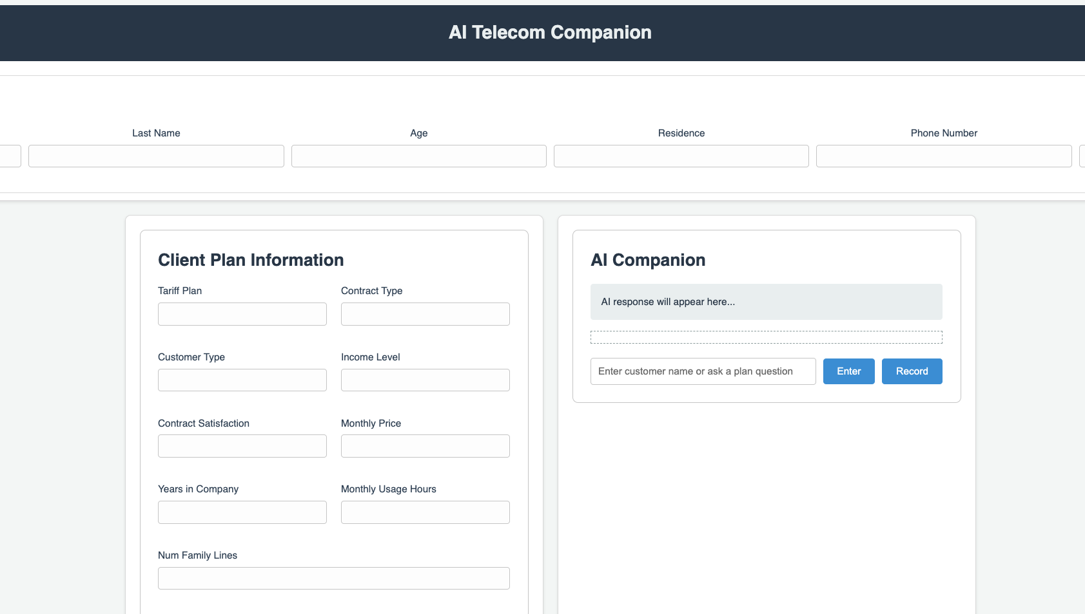
APP Showcase
We are going to show how the app works by giving a few examples of how our operators daily use of AI Telecom Companion would be.

Slide 7

Conclusion
As you can see, client retention and good service is our main goal to accomplish, thanks to AI Telecom Companion we are able to fulfill this task.
Objective 01
Objective 02
Objective 03
Client retention, to keep customers satisfied with the best offers.
Best service possible relying on the best tool available on the market.
Helping operator overcome daily struggles in their jobs thanks to AI.

Slide 8

THANK YOU!

Slide 9

















































Resource Page

